Slide 1
PRESS RELEASE
GHANA PRODUCER PRICE INDEX AND INFLATION
OCTOBER 2022
16TH November 2022

Slide 2
In this release, we present:
Definition and Measurement of the Producer Price Index (PPI)
Producer Price Index and Producer Inflation for October 2022
Disaggregation of the 2022 Producer Inflation
Highlights of October the 2022 Producer Inflation

Slide 3
Definition and Measurement of PPI and Inflation (1/2)
The Producer Price Index (PPI) measures the average change over time in the selling prices of goods and services as received by domestic producers.
Price collected for the computation of PPI are known as factory gate prices, which are the prices firms assign to their products.
These prices exclude sales and excise taxes, government subsidies other costs incurred by other intermediaries and consumers
The rate of Producer Inflation is the relative change in PPI between periods

Slide 4
Definition and Measurement of PPI and Inflation (2/2)
PPI computation is based on a fixed basket of products.
Firms are the primary source of data
Firms are selected based on the Integrated Business Establishment Survey
Variables for the computation of PPI are weights, prices, quantities and products.
Two reference periods for the computation of PPI are the weight reference (industry and product shares) and the index reference for price comparison.
The computation is done from a dual time perspective, monthly and annually

Slide 5
Reference Periods - PPI and Inflation
Weight Reference-2019
Weight reference at the industry level is based on 2019 Gross Value Output (GVO)
Selection of firms is based on the Integrated Business Establishment Survey (II)
Index Reference (Price Comparison)– March 2020 to February 2021 =100

Slide 6
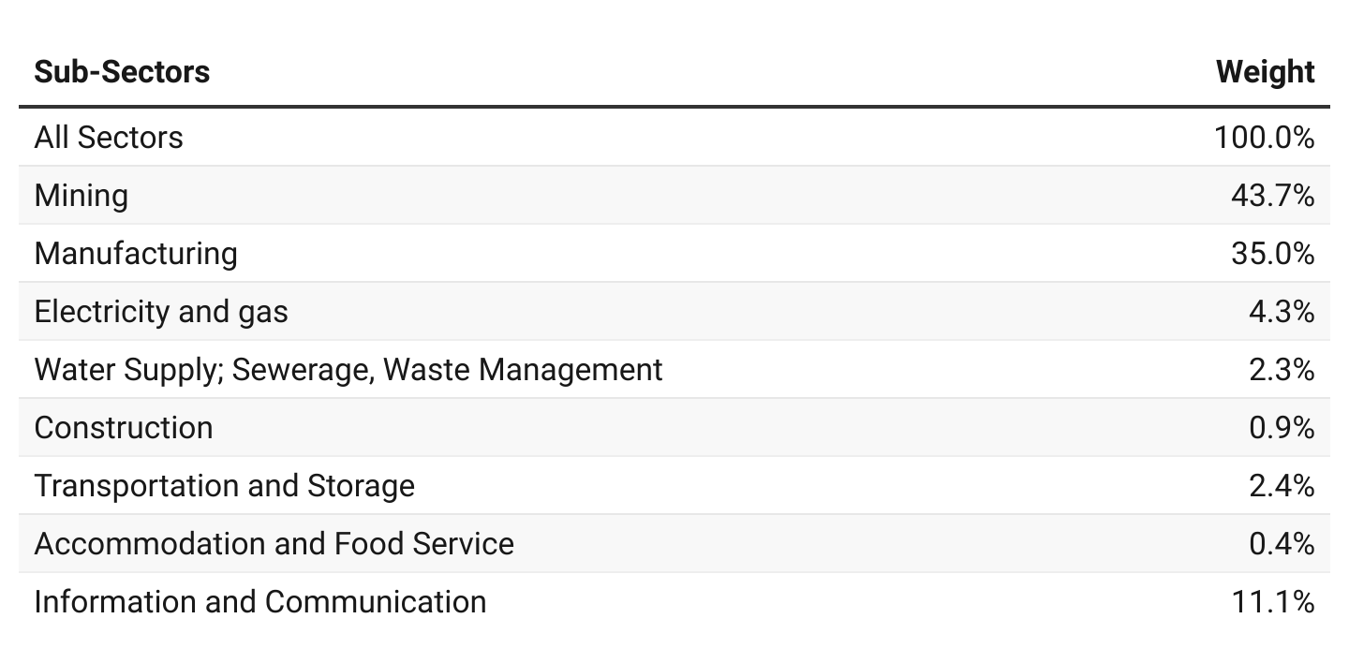
PPI Weights

Slide 7
Producer Price Index and Producer Inflation for October 2022
Year-on-year inflation rate at factory gate prices for all goods and services was 65.2 % in October 2022.
The monthly change rate was 15.4%.
Month | PPI (03/2020-02/2021 =100) | Inflation
 |  | Monthly | Yearly
Oct. 2021 | 112.2 | - | -
Sept. 2022 | 160.6 | 5.3 | 45.9
Oct. 2022 | p185.4 | p15.4 | p65.2
p = provisional
Notes:
The difference between year producer inflation for September 2021 and September 2022 was 5.9 percentage points and the monthly difference between August 2022 and September 2022 was also 5.8 percentage points

Slide 8
Disaggregation of the 2022 Producer Inflation by Sectors

Slide 9
Disaggregation of the 2022 Producer Inflation by Sub-Sectors
Notes:
Two {Manufacturing (58.2%) and Mining (57.5%)}of the eight subsectors recorded rates of produce inflation higher than the national (45.5%)
Electricity and water had the highest monthly producer inflation of 14.2% and 9.2% respectively

Slide 10
Sub-Sector Disaggregation – Sept Vs. Octo. 2022
Notes:
With the exception of Information and Communication and Construction sub-sectors all the other six sub-sectors recorded an increase in year-on-year producer inflation between August and September 2022. The highest change was recorded in the Electricity and Gas Sub-Sector increasing from 8.6% in August to 24.0% in September 2022.

Slide 11
Manufacturing Sub-Sector

Slide 12
Mining and Quarrying Sub-sector

Slide 13
Water supply, sewerage, and waste management Sub-Sector
Notes:
Producer inflation for Water Collection, Treatment and Supply between August 2022 and September 2022 increased by more than 19 percentage points.
Water was 13.6%

Slide 14
Construction Sub-Sector
Notes:
Construction 25.1%

Slide 15
Services Sub-sector
Notes:
Services was 5.6%

Slide 16
Highlights (1/2)
73.1 %
Manufacturing
86.4 %
Mining and quarrying
75.6 %
Industry
33.7 %
Electricity and gas
15.7 %
Water supply, sewerage and waste management
65.2 %
October 2022 yearly change in Producer Price Inflation
45.9 %
September 2022 yearly change in Producer Price Inflation
71.4 %
Transport and storage
23.0 %
Constructions
10.0 %
Service
42.1 %
Accomodation and food
1.5 %
Information and communication

Slide 17
Highlights (2/2)
12.5 %
Manufacturing
23.5 %
Mining and quarrying
17.5 %
Industry
8.1 %
Electricity and gas
2.0 %
Water supply, sewerage and waste management
15.4 %
October 2022 monthly change in Producer Price Inflation
5.3 %
September 2022 monthly change in Producer Price Inflation
35.3 %
Transport and storage
4.3 %
Service
3.8 %
Constructions
13.2 %
Accomodation and food
0.54 %
Information and communication

Slide 18
Thank You For enquiries, please contact Mr. Anthony Krakah Head, Industrial Statistics, Ghana Statistical Service Email: anthony.krakah@statsghana.gov.gh

